Slide 1

Utilizing Machine Learning for the Development of a Mobile Application and Web Extension for Predictive Mental Health Monitoring and Personalized Support
24-25J-293

Slide 2
Team
Supervisor : Mrs. Thilini Jayalath
Co- Supervisor : Mr. Deemantha Siriwardana
External Supervisor
  Mrs. Shalindi Pandithakoralage
  Mrs. Sachini Pathiraja
Student ID | Student Name | Specialization
IT21281778 | Alwis P.K.D.L.W | IT
IT21306204 | De Alwis K.C. | IT
IT21377730 | Ameen F.A. | IT
IT21346736 | Jahani M.J.A. | IT

Slide 3
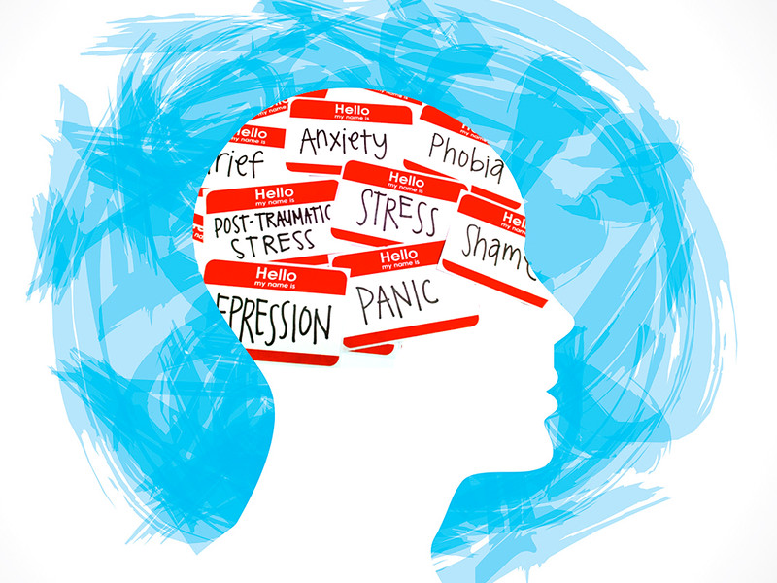
  Research Problem
With the increasing reliance on digital technology, individuals' mental health is often influenced by their online interactions and behaviors. However, there is a lack of comprehensive tools that can accurately track and analyze these behaviors to provide timely and personalized mental health support.
This Photo by Unknown Author is licensed under CC BY

Slide 4
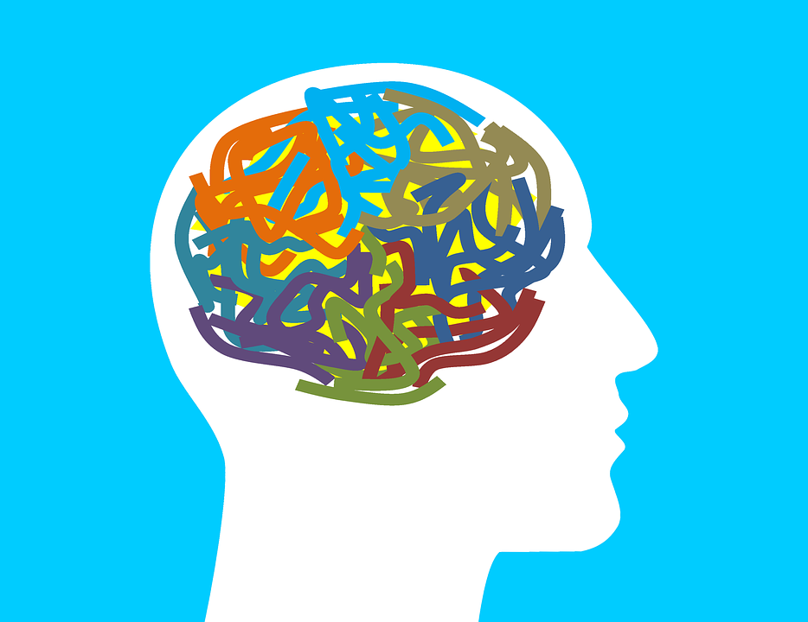
  Introduction to the project
Objective:
  Develop a mobile application and web extension to track user behavior and patterns and support them to get ride of Depression and Anxiety.
Key Features:
Machine Learning Analysis:
  Analyzes digital interactions (emails, messages, social media, web searches, physical activities, songs, self-assessments, screen time) to assess mental health status.
Emotional State Assessment:
  Gauges emotional state based on behavior patterns.
Support Mechanism:
  Provides tailored support when mental health is not critical:
    Music: Personalized playlists.
    Activities: Engaging exercises.
    Meditation: Guided sessions.
Goal:
  Manage stress and maintain a positive outlook for improved well-being.

Slide 5
Achievements & Completed Milestones
Data Collection: Successfully gathered all relevant datasets for analysis.
Industry Collaboration: Engaged with industry experts, including psychologists, to align the project with real-world needs.
Wireframe Design: Crafted the initial wireframes for user interface design.
Model Development: Built all required models for the project’s core functionality.

Slide 6
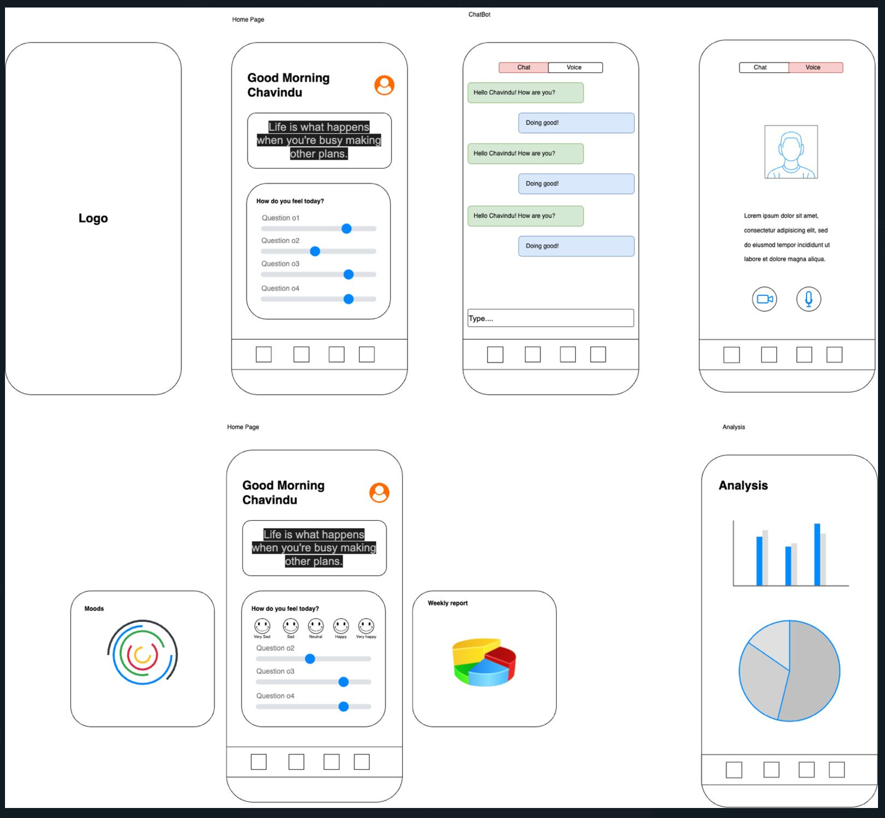
UI

Slide 7
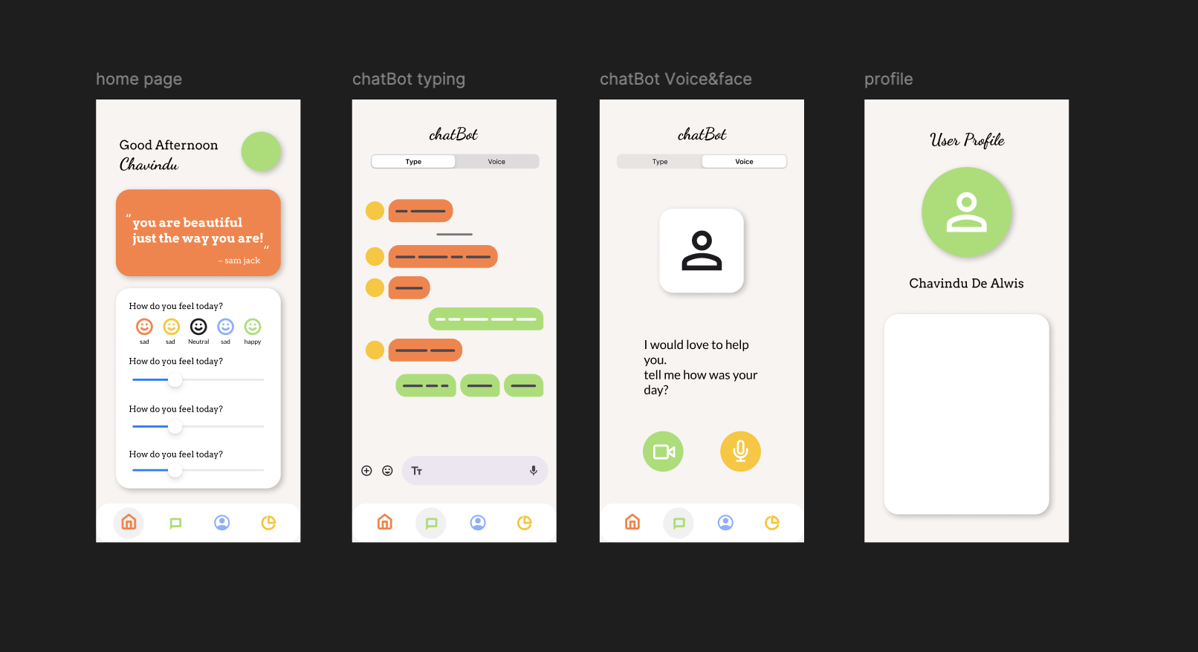

Slide 8
Roadmap Ahead
Backend Development:
Integrate models into the backend.
Ensure secure and efficient data handling.
Focus on user experience and interface smoothness.
Ensure seamless interaction with the backend.
What's Next?

Slide 9
Our Progress So Far
Completed
Ongoing
Backend Development: 80%
UI Frontend: 60%
Data Collection: 100%
Industry Collaboration: 100%
Wireframes: 100%
Model Development: 100%

Slide 10
Team Contributions

Slide 11
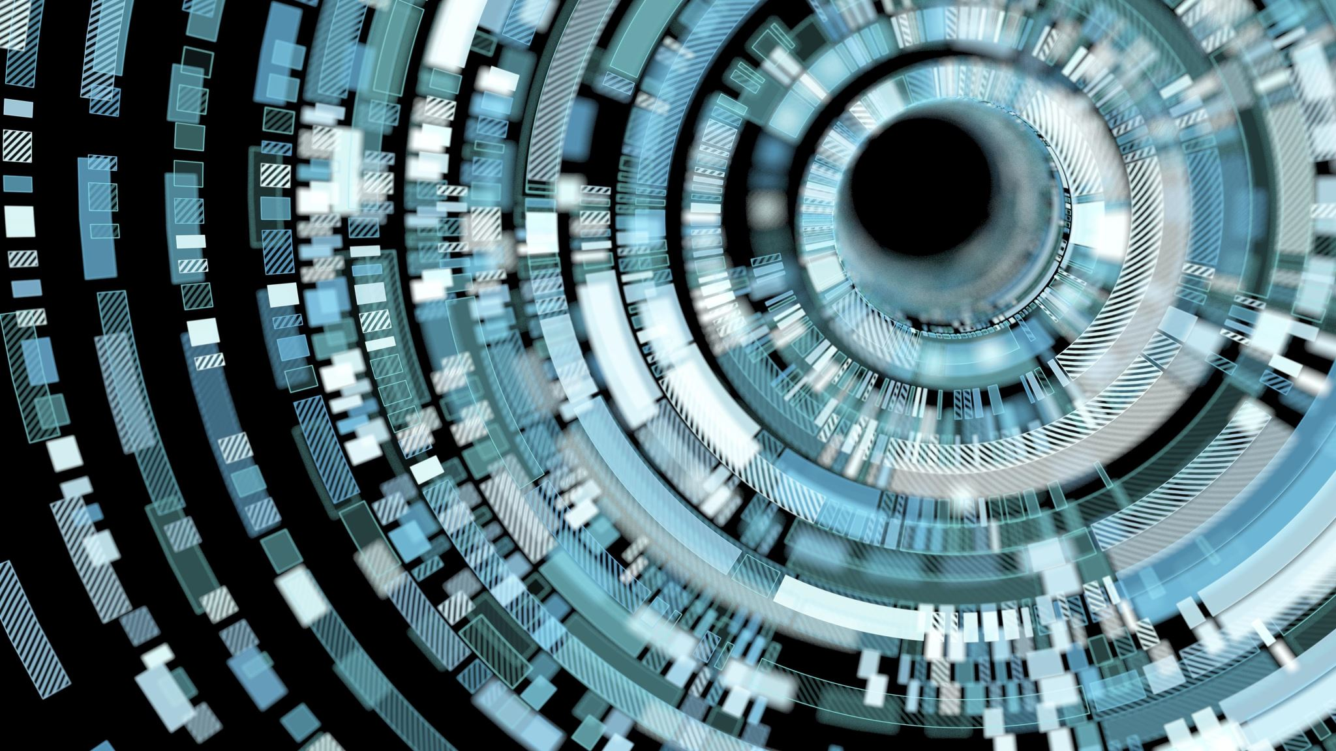
track user behavior and patterns, analyzing their mental health status using machine learning
IT21281778 | Alwis P.K.D.L.W | 24-25J-293

Slide 12

Datasets
Sentimental Dataset - https://www.kaggle.com/datasets/suchintikasarkar/sentiment-analysis-for-mental-health/data
ScreenTime Dataset - https://www.kaggle.com/code/waqi786/mind-tech-unveiling-the-impact/input
ThePhoto by PhotoAuthor is licensed under CCYYSA.
IT21281778 | Alwis P.K.D.L.W | 24-25J-293

Slide 13
Progress So Far
Completed
Ongoing
All Software architected
Data Collection: 100%
Model Training:80%
Web extention:100%
Model Development: 100%
Mobile App: 75% (User, Screentime,Chat bot)
Cloud Environment creating: 25%
Run models on Flask
Deploy software in Azure
Send screentime data to backend
Enhance UIs of Mobile App
Screentime APIs
Enhance Backend

Slide 14
MOdels
Random Forest Regressor
Gradient Boosting Regressor
Train SVR
Logistic Regression with TF-IDF Vectorization
IT21281778 | Alwis P.K.D.L.W | 24-25J-293

Slide 15
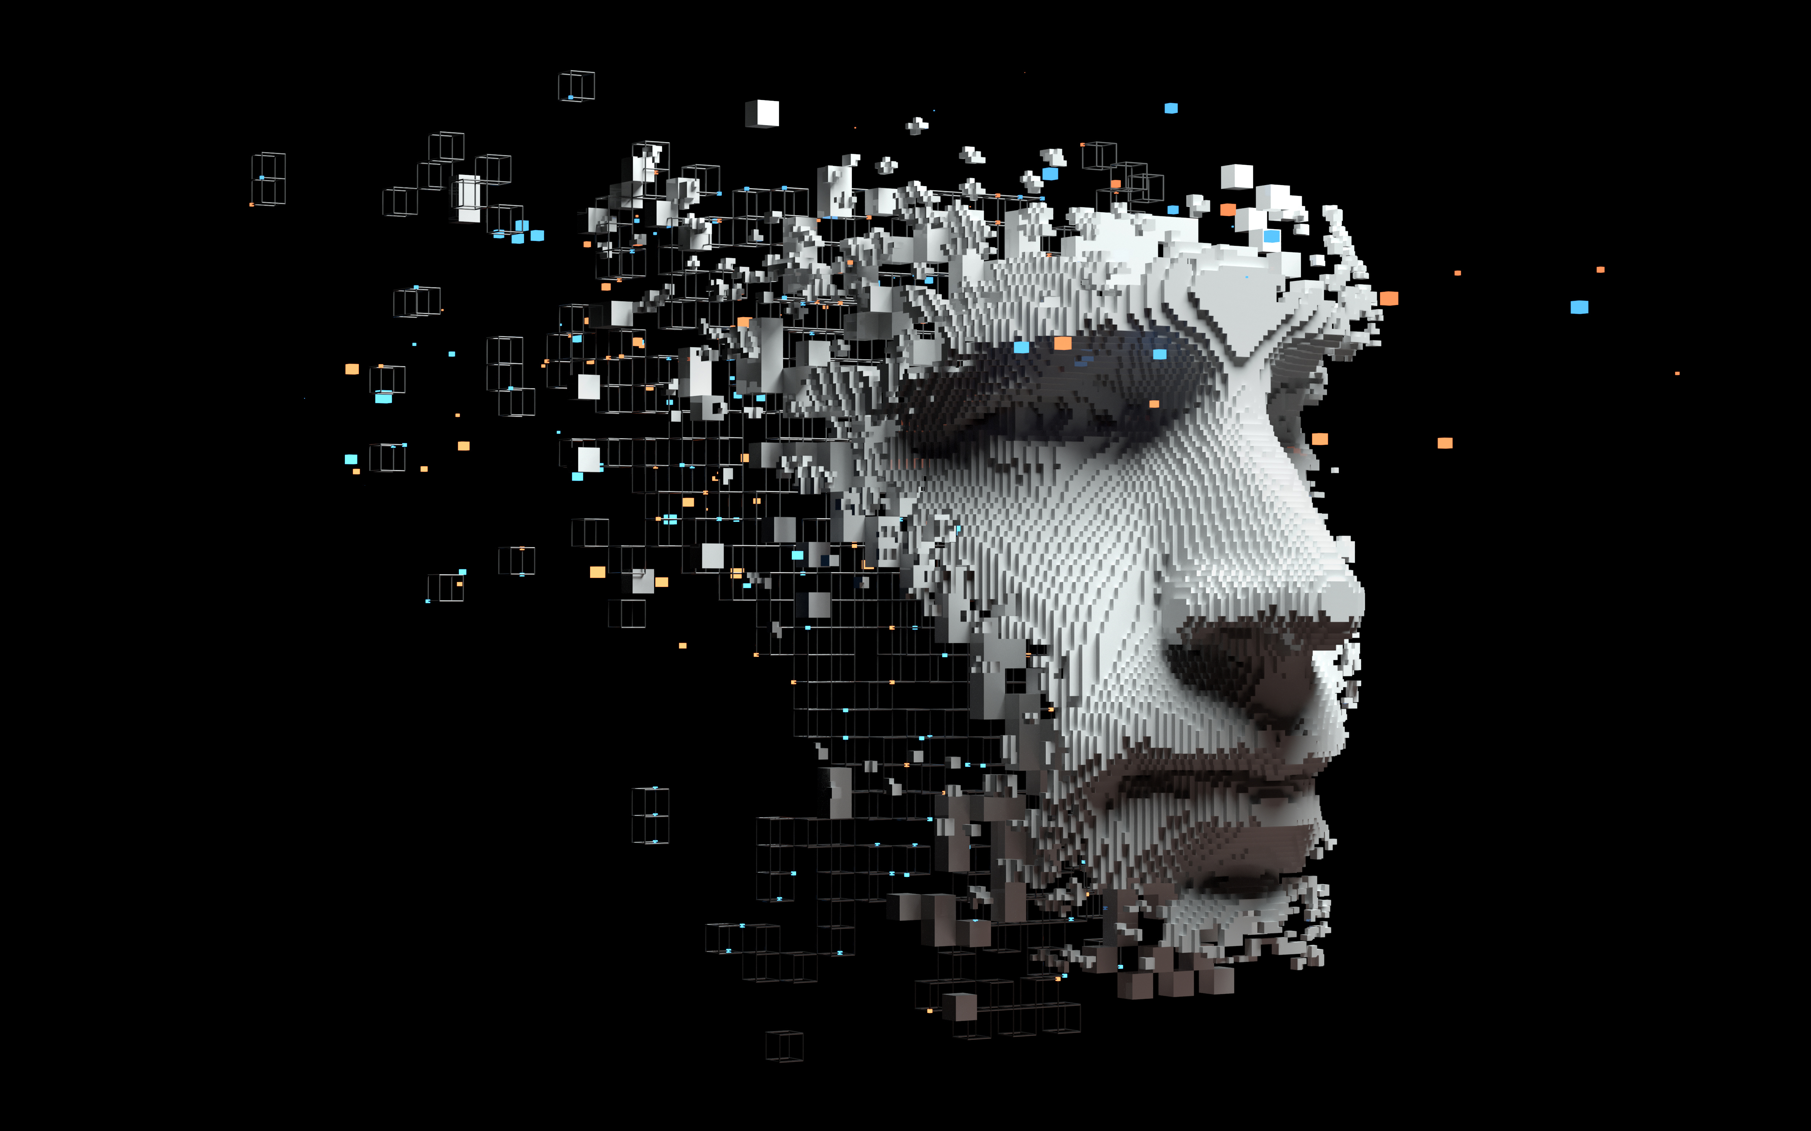
Daily user emotion Data Collection, Voice, and Data Integration Mental Health System
IT21306204 | De Alwis K.C. | 24-25J-293

Slide 16
Progress So Far
Completed
Ongoing
Voice-chatbot integration : 30%
UI Frontend: 60%
Analytics Page [on going]
Data Collection: 100%
UI design: 100%
Wireframes: 100%
Model Development: 100%
DailyForm Development 100%

Slide 17
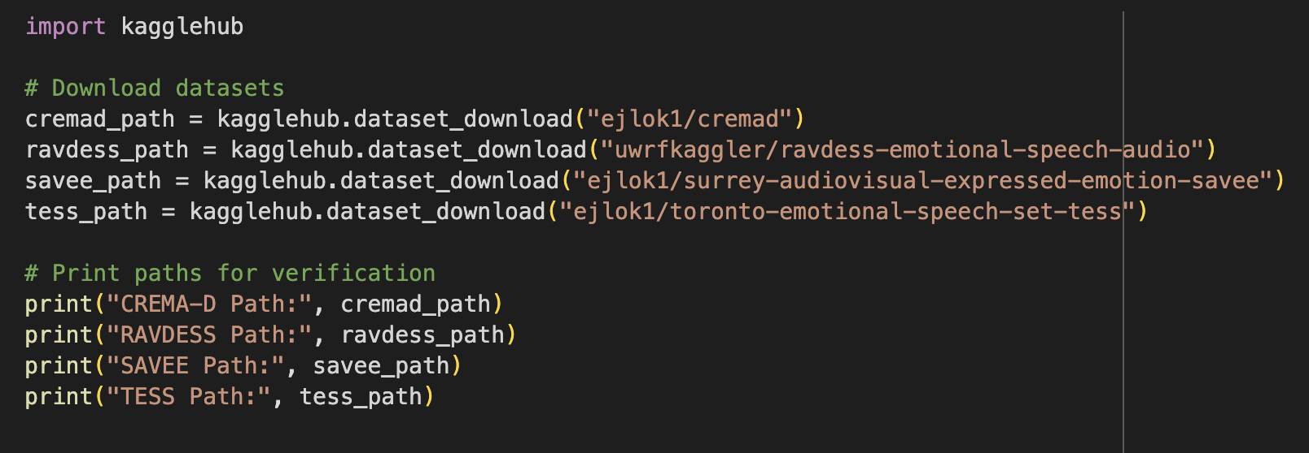
Datasets
CREMA-D - https://www.kaggle.com/datasets/ejlok1/cremad/data
TESS - https://www.kaggle.com/datasets/ejlok1/toronto-emotional-speech-set-tess
SAVEE - https://www.kaggle.com/datasets/ejlok1/surrey-audiovisual-expressed-emotion-savee
RAVDESS - https://www.kaggle.com/datasets/uwrfkaggler/ravdess-emotional-speech-audio
IT21306204 | De Alwis K.C. | 24-25J-293

Slide 18
Model for voice recognition
Models
Convolutional Neural Network (CNN)
SVC model
KNeighborsClassifier model
RandomForestClassifier model
modelTesting - https://colab.research.google.com/drive/1ShSTIwj9uyFaEiRiqKuM2EVCUQy1d8un#scrollTo=y6m81Gcx4wbw
EmotionVoiceMLmodel -
https://colab.research.google.com/drive/1J7QlUZA-4nEV80D0rZsLJ-36_Mp3cQCy#scrollTo=4bH3-qOn2YrG
IT21306204 | De Alwis K.C. | 24-25J-293

Slide 19
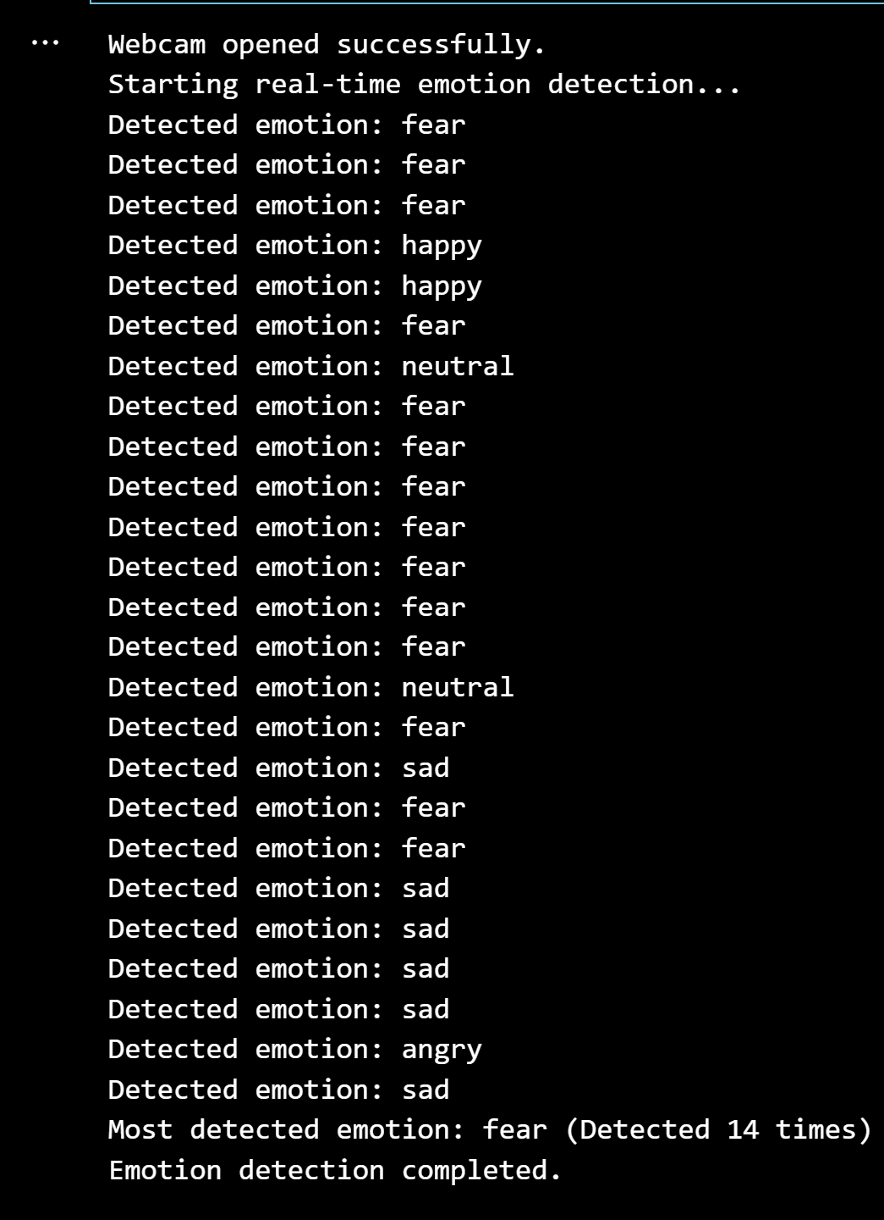
Real-Time EMOTION DETECTOR THROUGH FACIAL EXPRESSIONS.
IT21306204 | De Alwis K.C. | 24-25J-293

Slide 20
Progress So Far
Completed
Data Collection: 100%
Model Development: 100%
Frontend Development 95%
Backend Development and Integration- 100%

Slide 21
MODELs & DATASETS
Model Used
DeepFace (VGG-Face, Facenet)
Libraries Used
DeepFace: Emotion analysis
OpenCV: Face detection
Matplotlib: Visualization
Pandas: Optional for data handling
Datasets Used
https://www.kaggle.com/datasets/sanidhyak/human-face-emotions

Slide 22
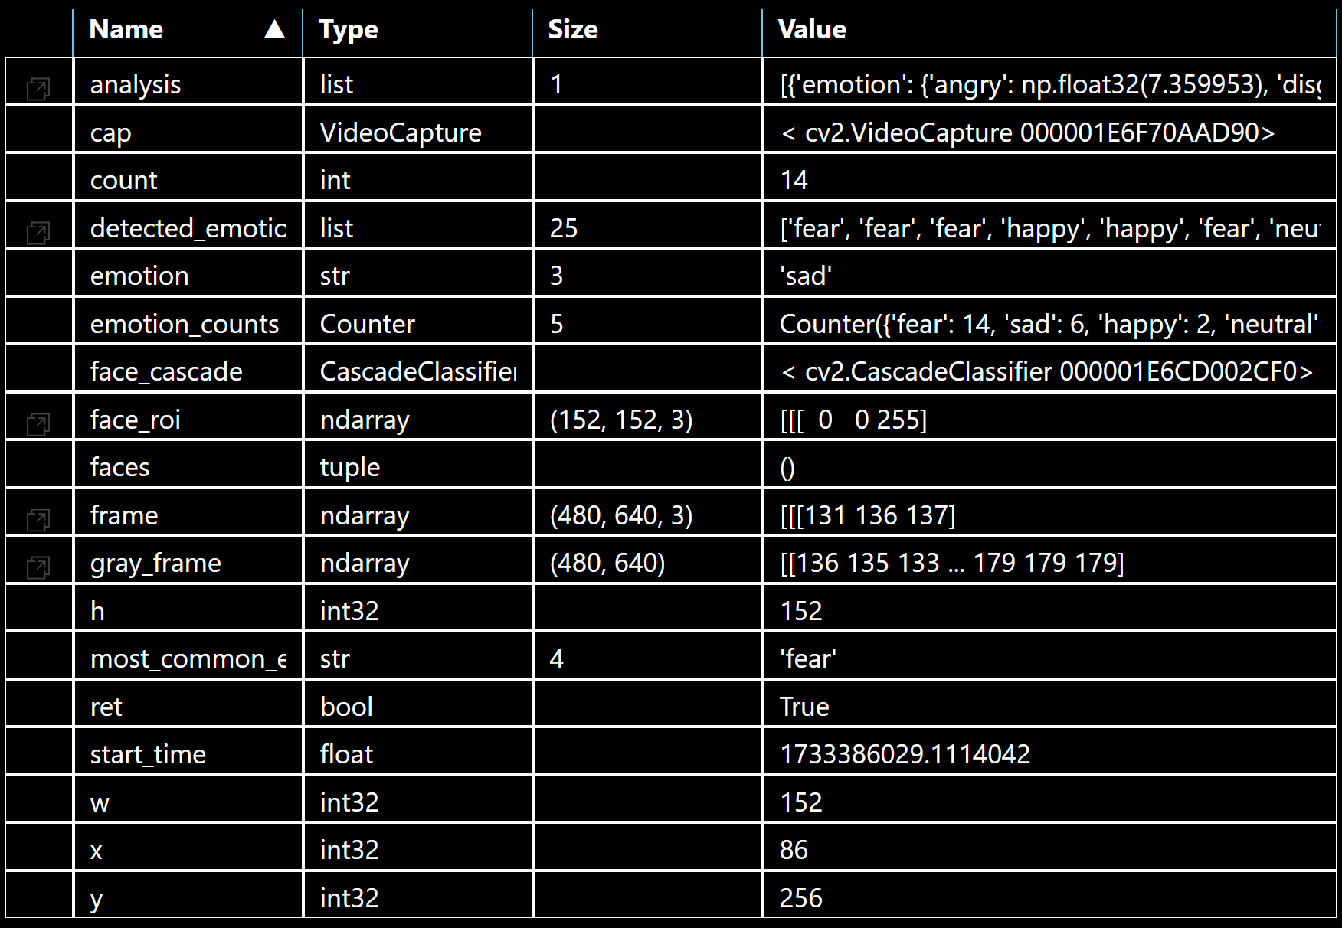
Terminal View
The fifth row 'emotion' states the final observed emotion of the user.

Slide 23
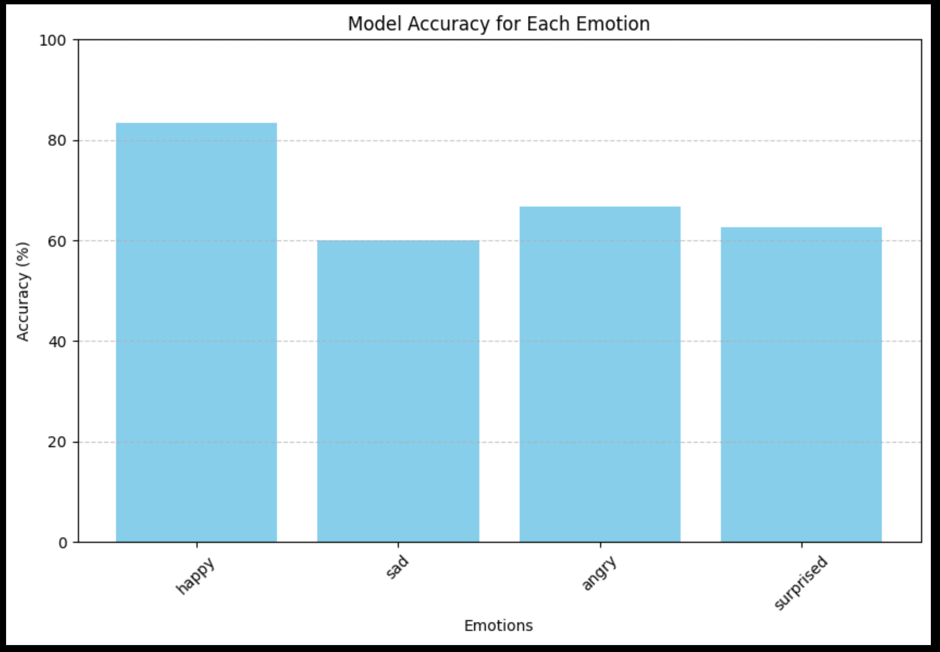
Accuracy plot

Slide 24
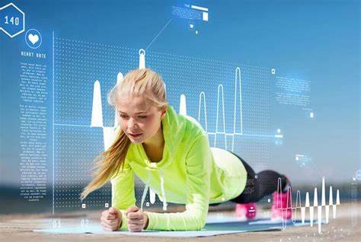
Incorporating biometrics to detect emotional state and EnhancE Mental health support
IT21306204 | De Alwis K.C. | 24-25J-293

Slide 25
Progress So Far
Completed
Ongoing
Data Collection: 100%
UI design: 100%
Wireframes: 100%
Model Development: 100%
Frontend Development 95%
Backend Development and Integration- 100%
HRV Analysis: 70%[ongoing]
UI Frontend: 95%
Sensor: 85%

Slide 26
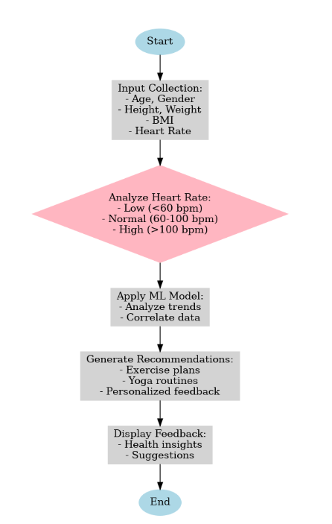
Methodology
Build an app integrating heart rate monitoring for emotional well-being is real-time emotional insight based on heart rate variability (HRV).
This feature continuously tracks and analyzes users' heart rate data to provide immediate feedback on their emotional states.
This real-time analysis enables users to better understand their emotional patterns and make informed decisions about their mental well-being, fostering proactive management and support.
IT21306204 | De Alwis K.C. | 24-25J-293

Slide 27
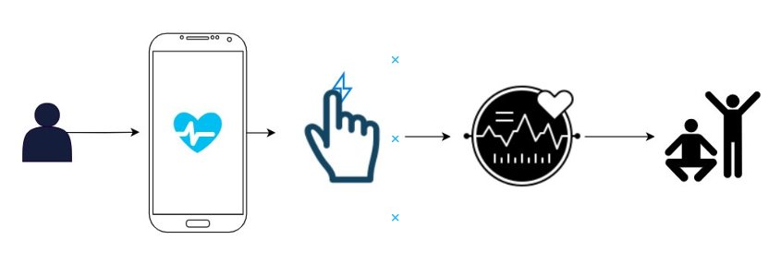
Step 1: Obtain the heart rate by using Photoplethysmography.​
Step 2: Analyze the heart rate and using machine learning algorithms determine emotional state.​
Step 3: By identifying the emotional state provide feedback and exercises to the user accordingly.​
Step 4: Monitor user heart rate for future analysis.

Slide 28
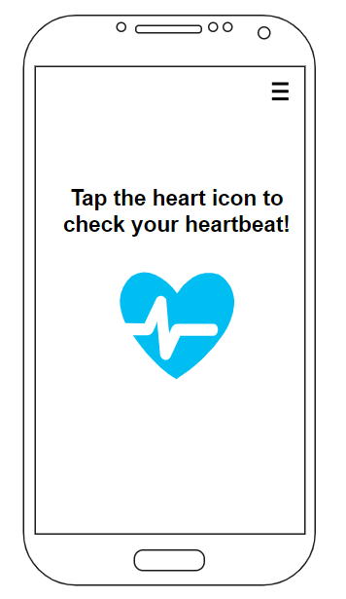
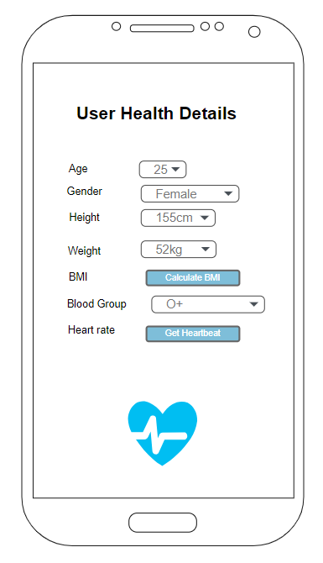
Wireframes
IT21306204 | De Alwis K.C. | 24-25J-293

Slide 29
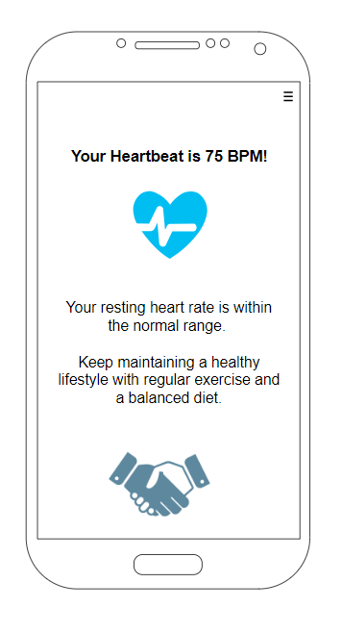
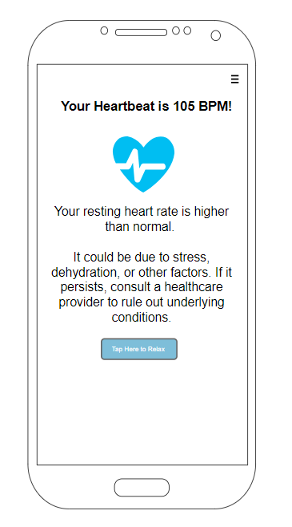
IT21306204 | De Alwis K.C. | 24-25J-293

Slide 30
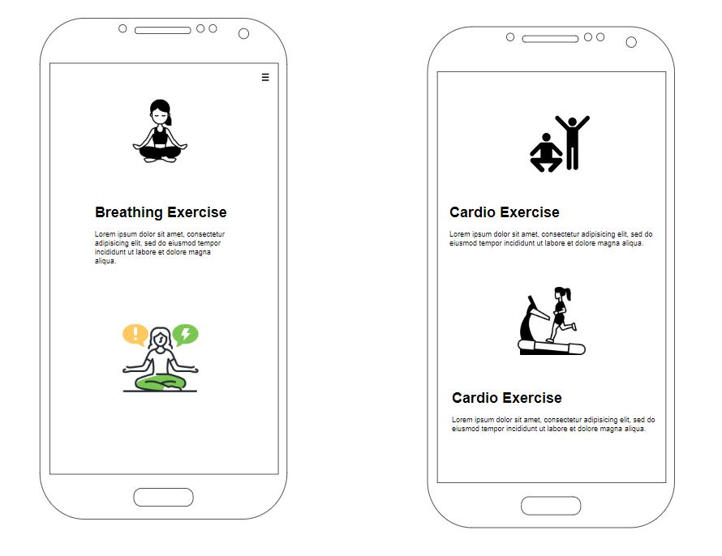
IT21306204 | De Alwis K.C. | 24-25J-293

Slide 31
Libraries and Imports
pandas: For data manipulation and creating the input dataframe.
joblib: To load a pre-trained machine learning model.
warnings: Used to suppress warnings for a cleaner output.
Machine learning-related libraries (sklearn imports): model to preprocess data and train a RandomForestClassifier.

Slide 32
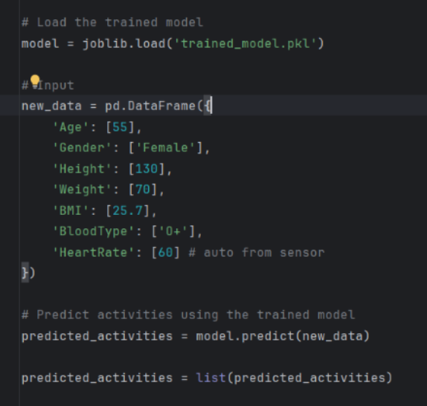
Libraries and Imports
Input Data
The input data is created as a pandas.DataFrame.
Each feature represents individual characteristics:
Age, Gender, Height, Weight: Basic demographic and physical attributes.
BMI: Calculated based on height and weight to represent the Body Mass Index.
BloodType: Used for personalization in activity recommendations (though its relevance might depend on specific use cases).
HeartRate: Captured in real-time, likely using a wearable sensor or device, reflecting the user's physiological state.

Slide 33
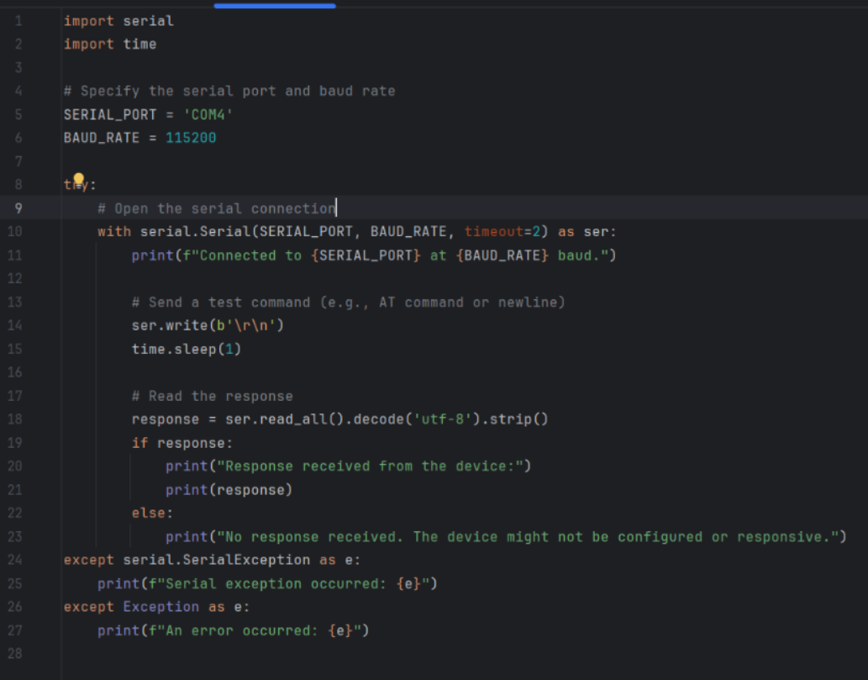
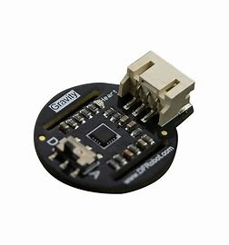
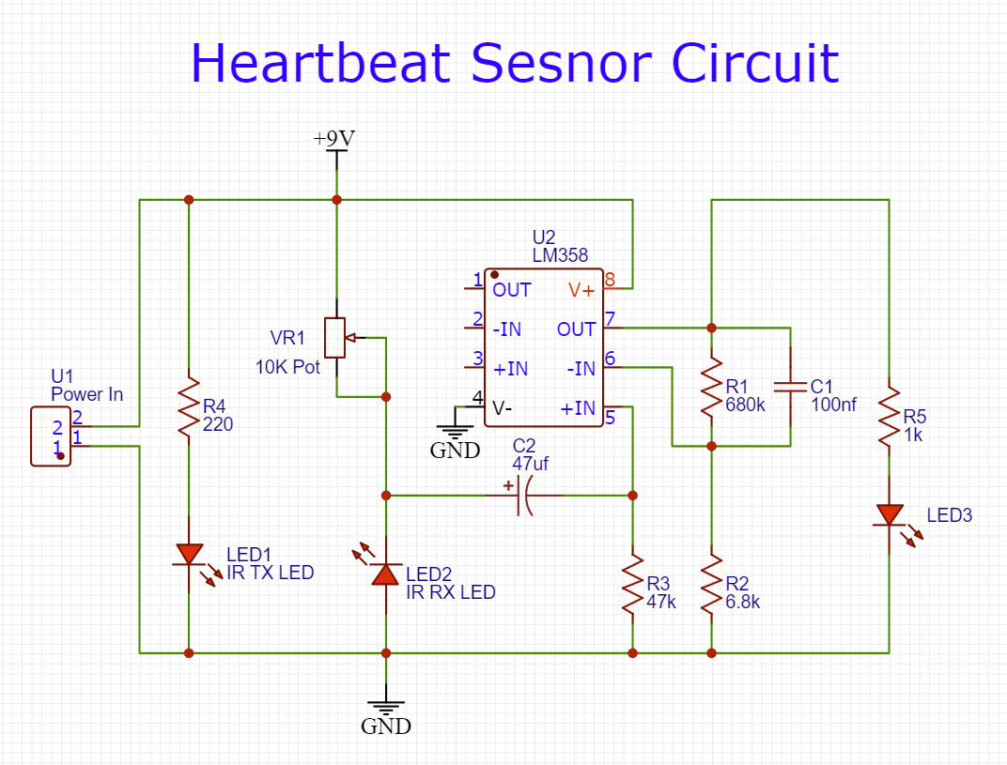
code in the screenshot focus serial communication on interface with hardware components such as sensor(Arduino).
This script plays a crucial role in bridging the hardware (sensor) with the software, in order to obtain the heartbeat rate.

Slide 34

FUTURE Enhancements for the Project
Dynamic Input:
  Develop a GUI or API to collect real-time data, making the system user-friendly.
Model Improvements:
  Evaluate the model's performance using metrics like accuracy, precision, and recall.
Validation:
  Perform rigorous testing using diverse datasets to ensure the model generalizes well.

Slide 35
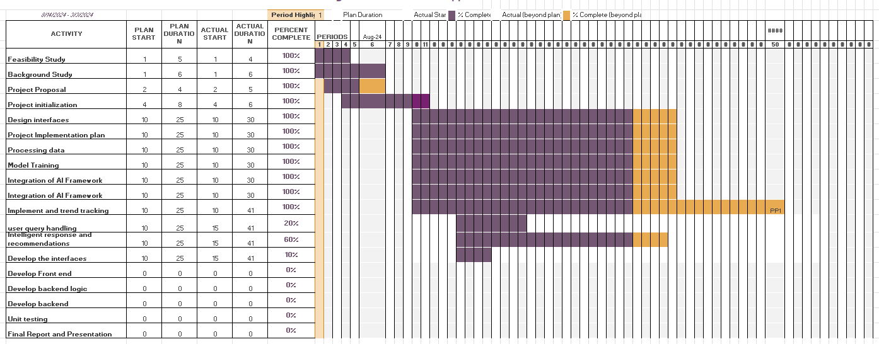
Gantt Chart

Slide 36
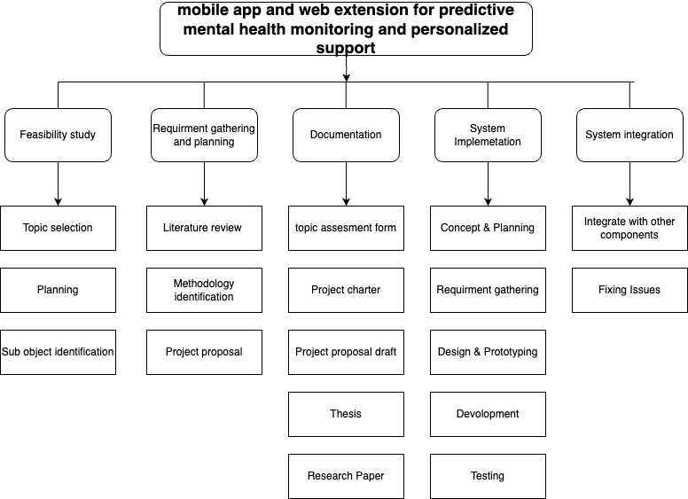
Work Breakdown Structure
ITXXXXXXXX | <<Student Name>> | <<Project ID>>

Slide 37
Collaboration Tools & Resources
Github Repository:
"Explore all code, files, and documentation here.“
Project Management Tool:
Link: https://github.com/users/MasterLWA/projects/11/views/1
"Track tasks, monitor progress, and stay organized with our tool."
IT21306204 | De Alwis K.C. | 24-25J-293

Slide 38
Project Repos
Flask Server
NodeJS Server as a main Server
Flutter Project
Web Extention
IT21281778 | Alwis P.K.D.L.W | 24-25J-293

Slide 39
Commercialization
Features | Free | Pro
Advertisements | Yes | No
Priority Support | No | Yes
Extended Historical Data | No(Short term) | Yes(Long Term)
Background Music Playing | No | Yes
Sync Among Devices | 2 Devices | Unlimited
$9.99 dollars per month for a Pro version (Subscription Model).

Slide 40
Thank you!

